Slide 1

Finančné trhy
Marek Prokopec
Predseda predstavenstva SASS
Február 2023

Slide 2
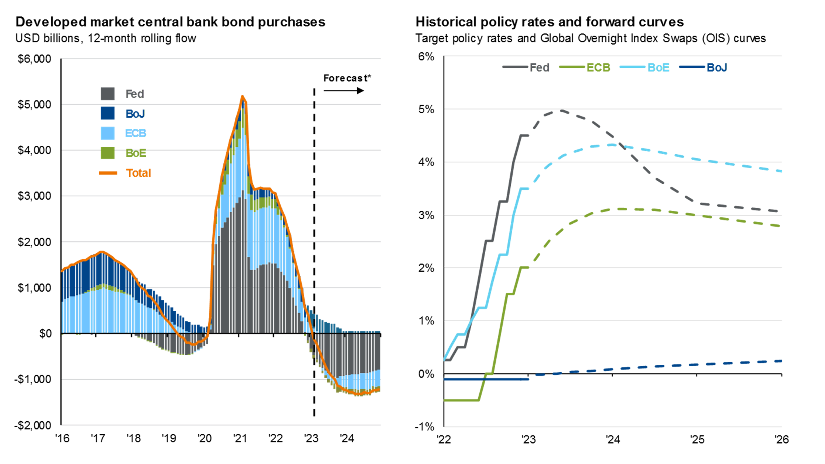
https://am.jpmorgan.com/us/en/asset-management/adv/insights/market-insights/guide-to-the-markets/

Slide 3
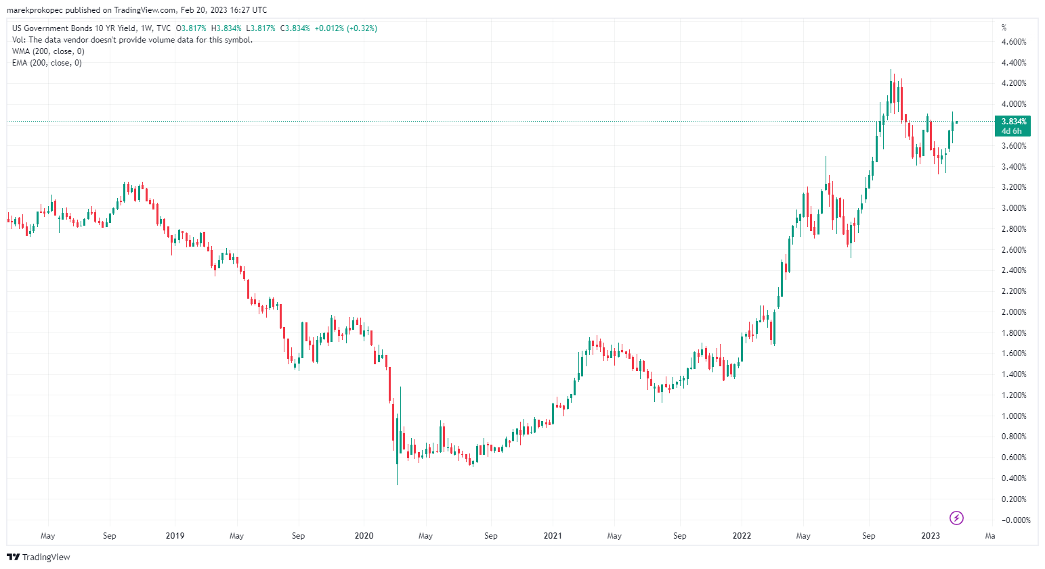
US Gov Bond Yields

Slide 4
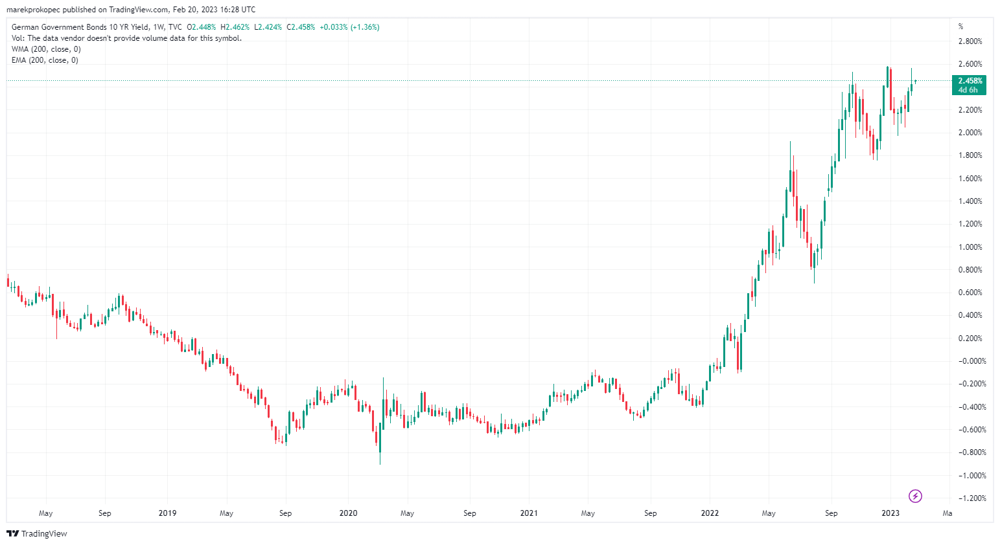
GER Gov Bond Yields

Slide 5
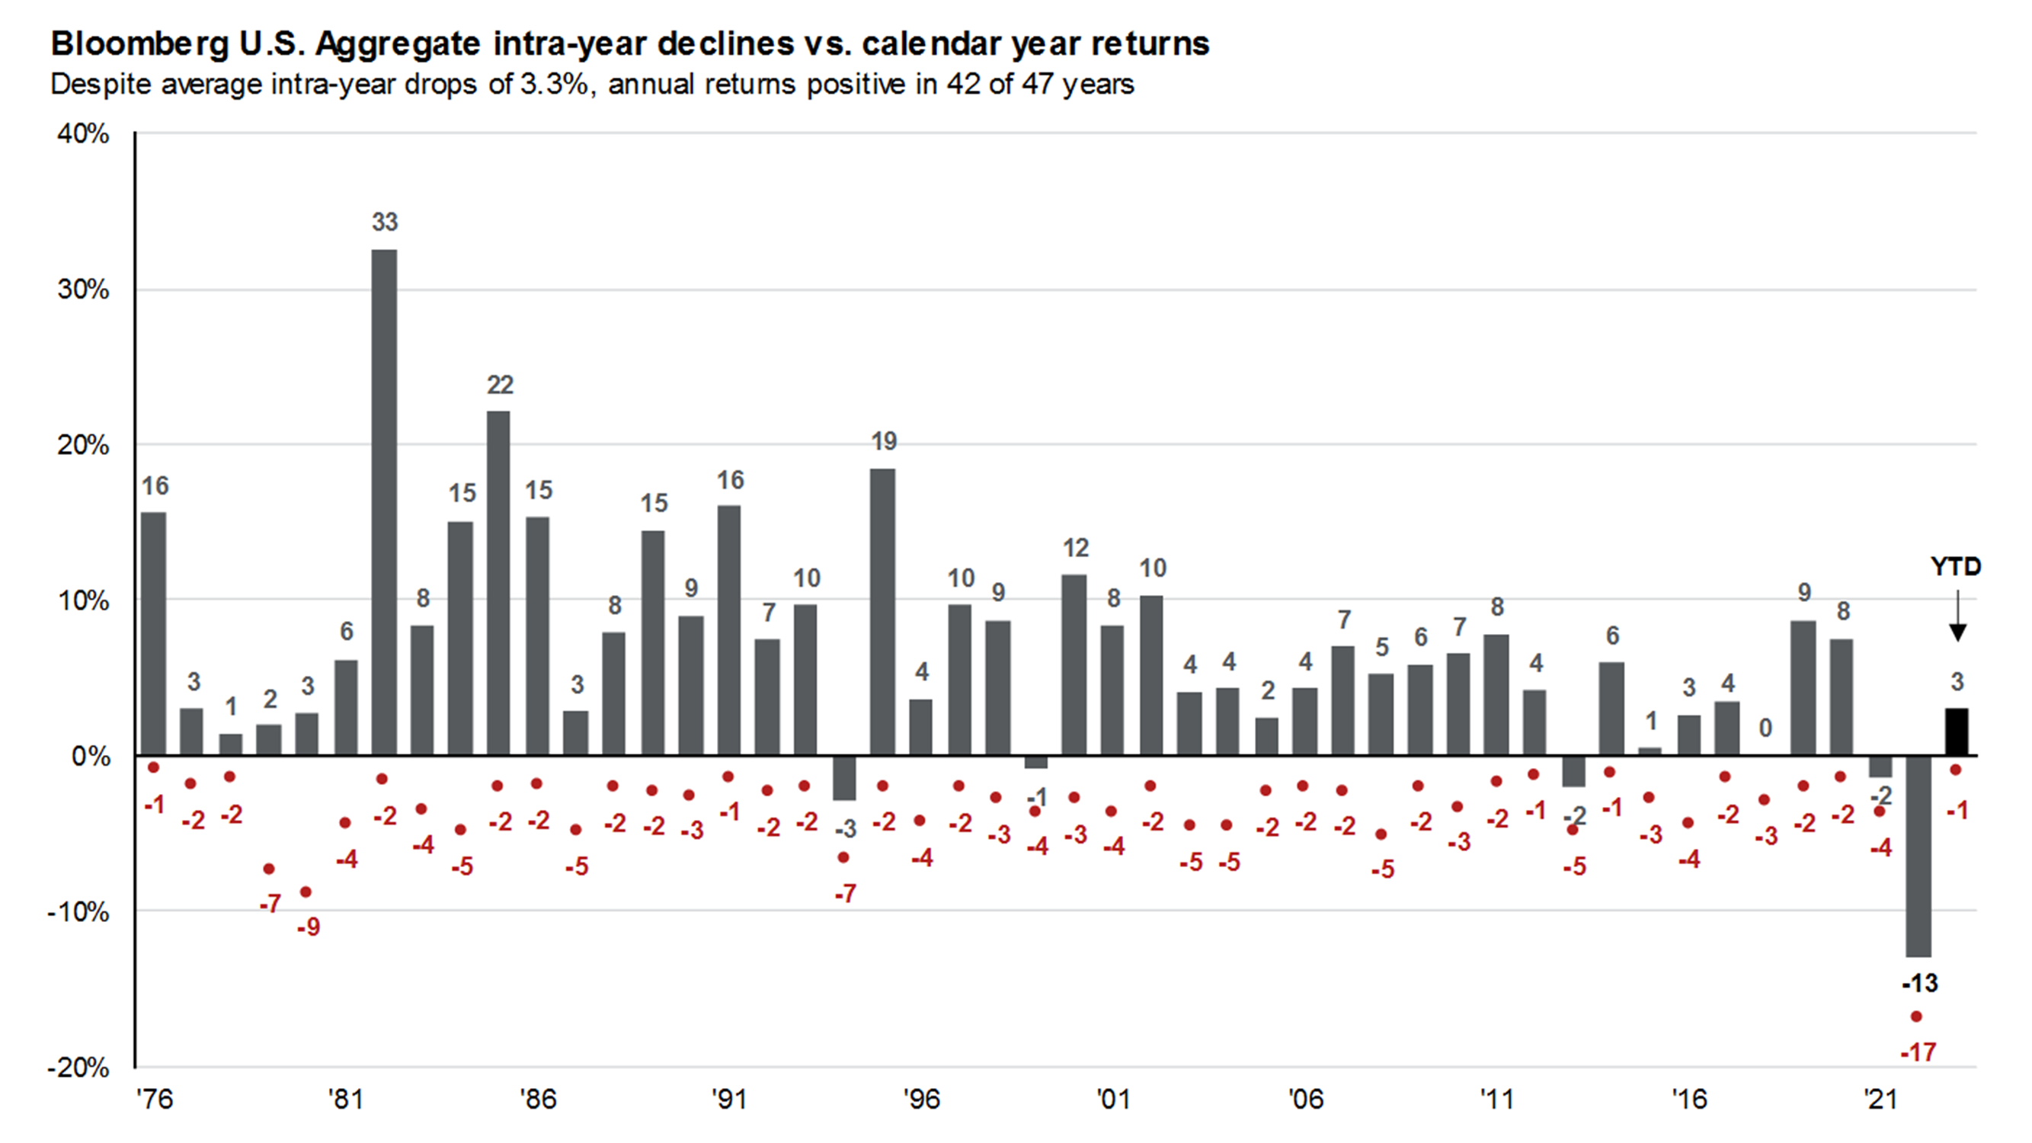
https://am.jpmorgan.com/us/en/asset-management/adv/insights/market-insights/guide-to-the-markets/

Slide 6
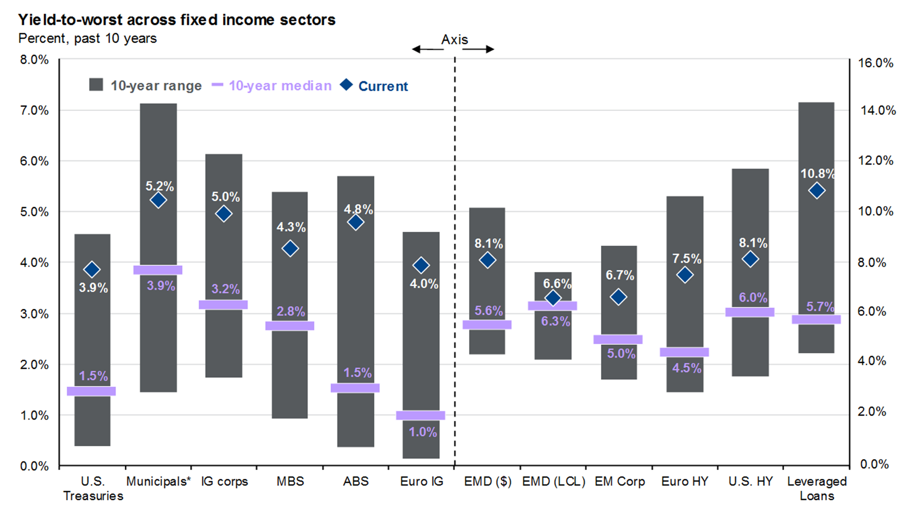
https://am.jpmorgan.com/us/en/asset-management/adv/insights/market-insights/guide-to-the-markets/

Slide 7
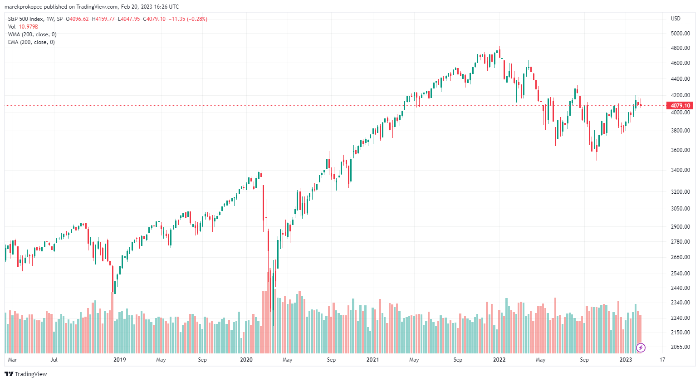
Akcie – S&P500

Slide 8
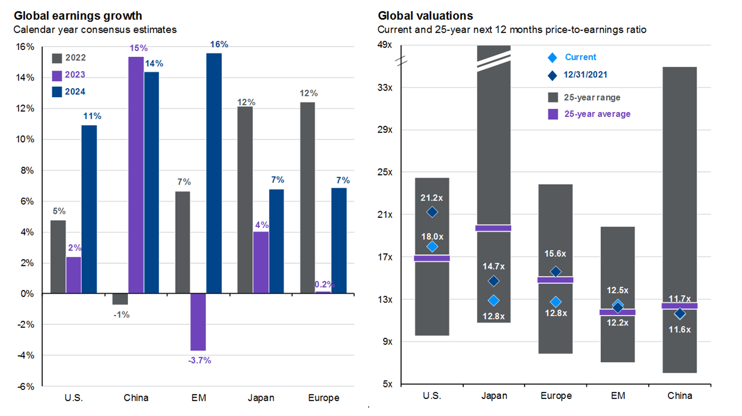
v
https://am.jpmorgan.com/us/en/asset-management/adv/insights/market-insights/guide-to-the-markets/

Slide 9
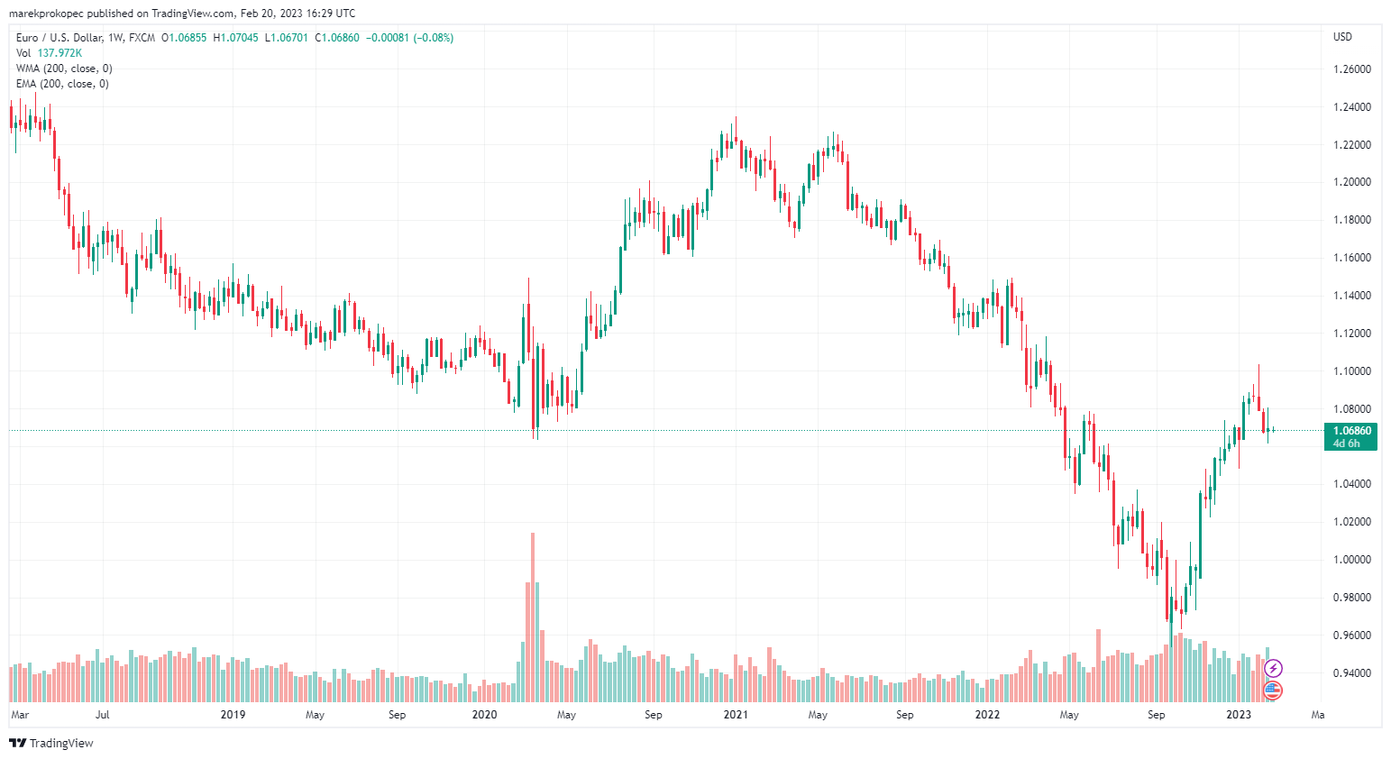
EURUSD

Slide 10
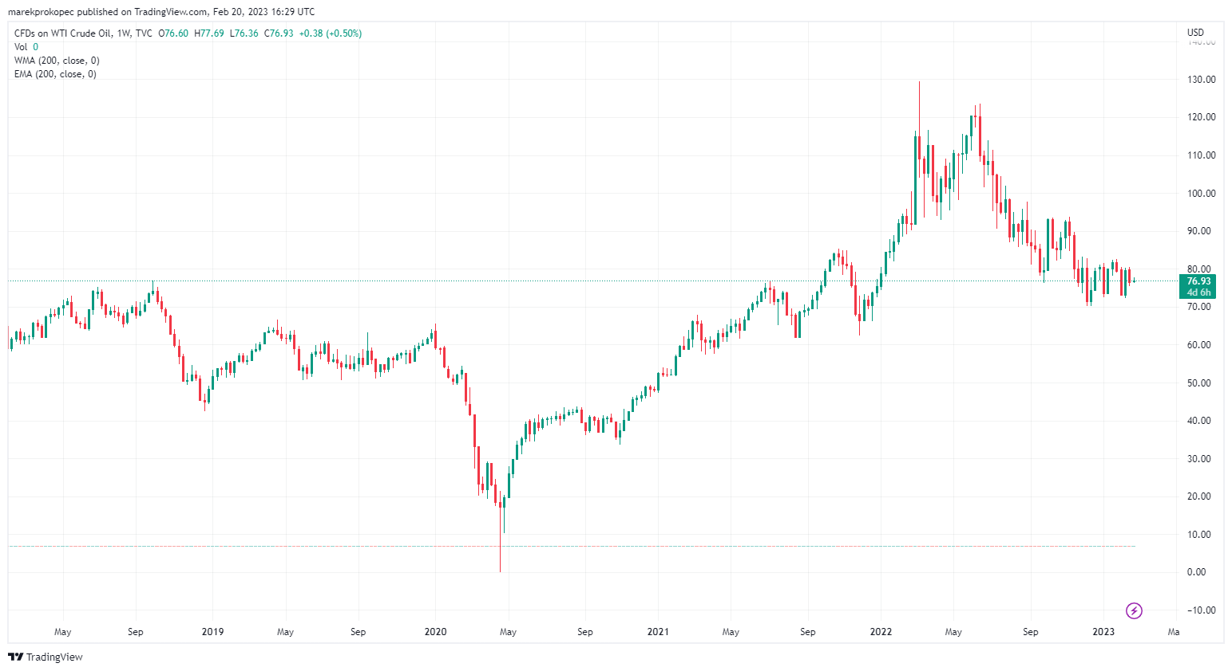
WTI Crude Oil

Slide 11
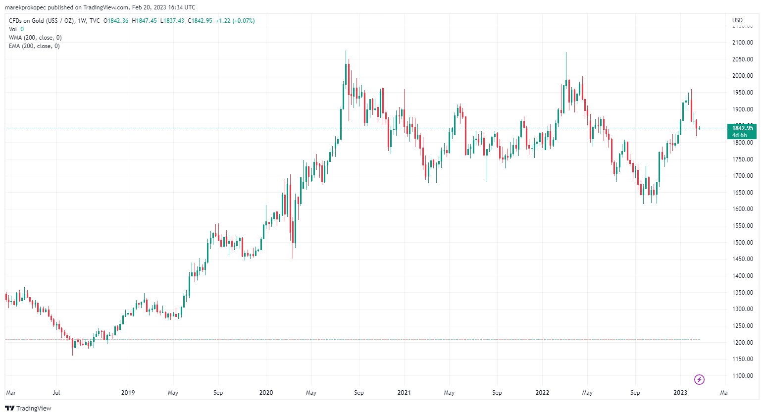
Zlato

Slide 12
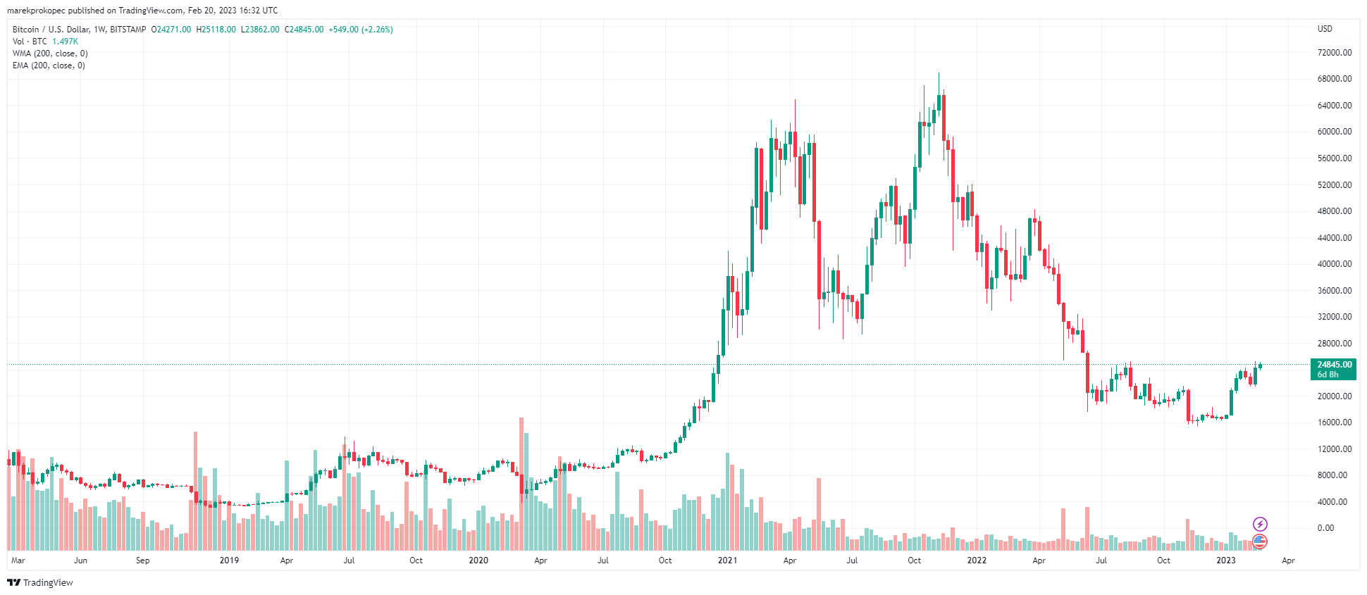
Bitcoin

Slide 13
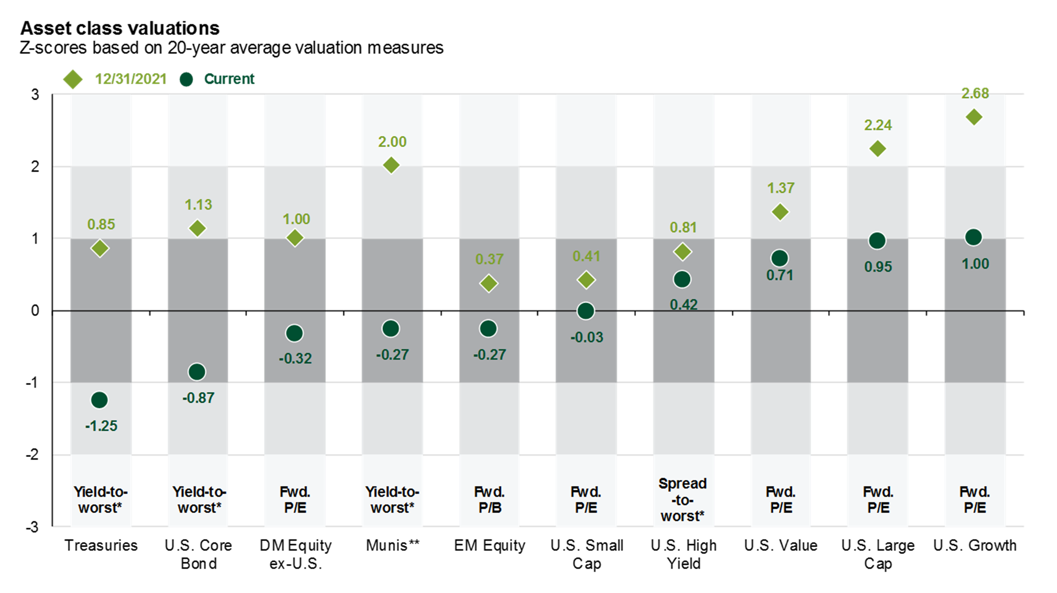
https://am.jpmorgan.com/us/en/asset-management/adv/insights/market-insights/guide-to-the-markets/

Slide 14
Ďakujem za Vašu pozornosť.

