Slide 1
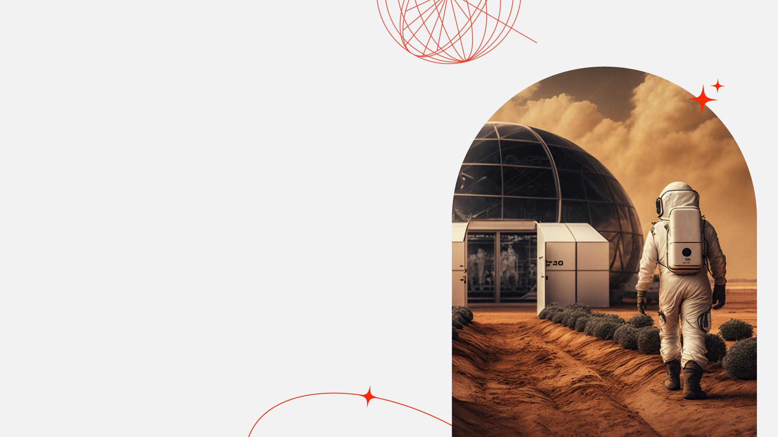

Why to act in space business?
VytahConf.com intro presentation

Slide 2
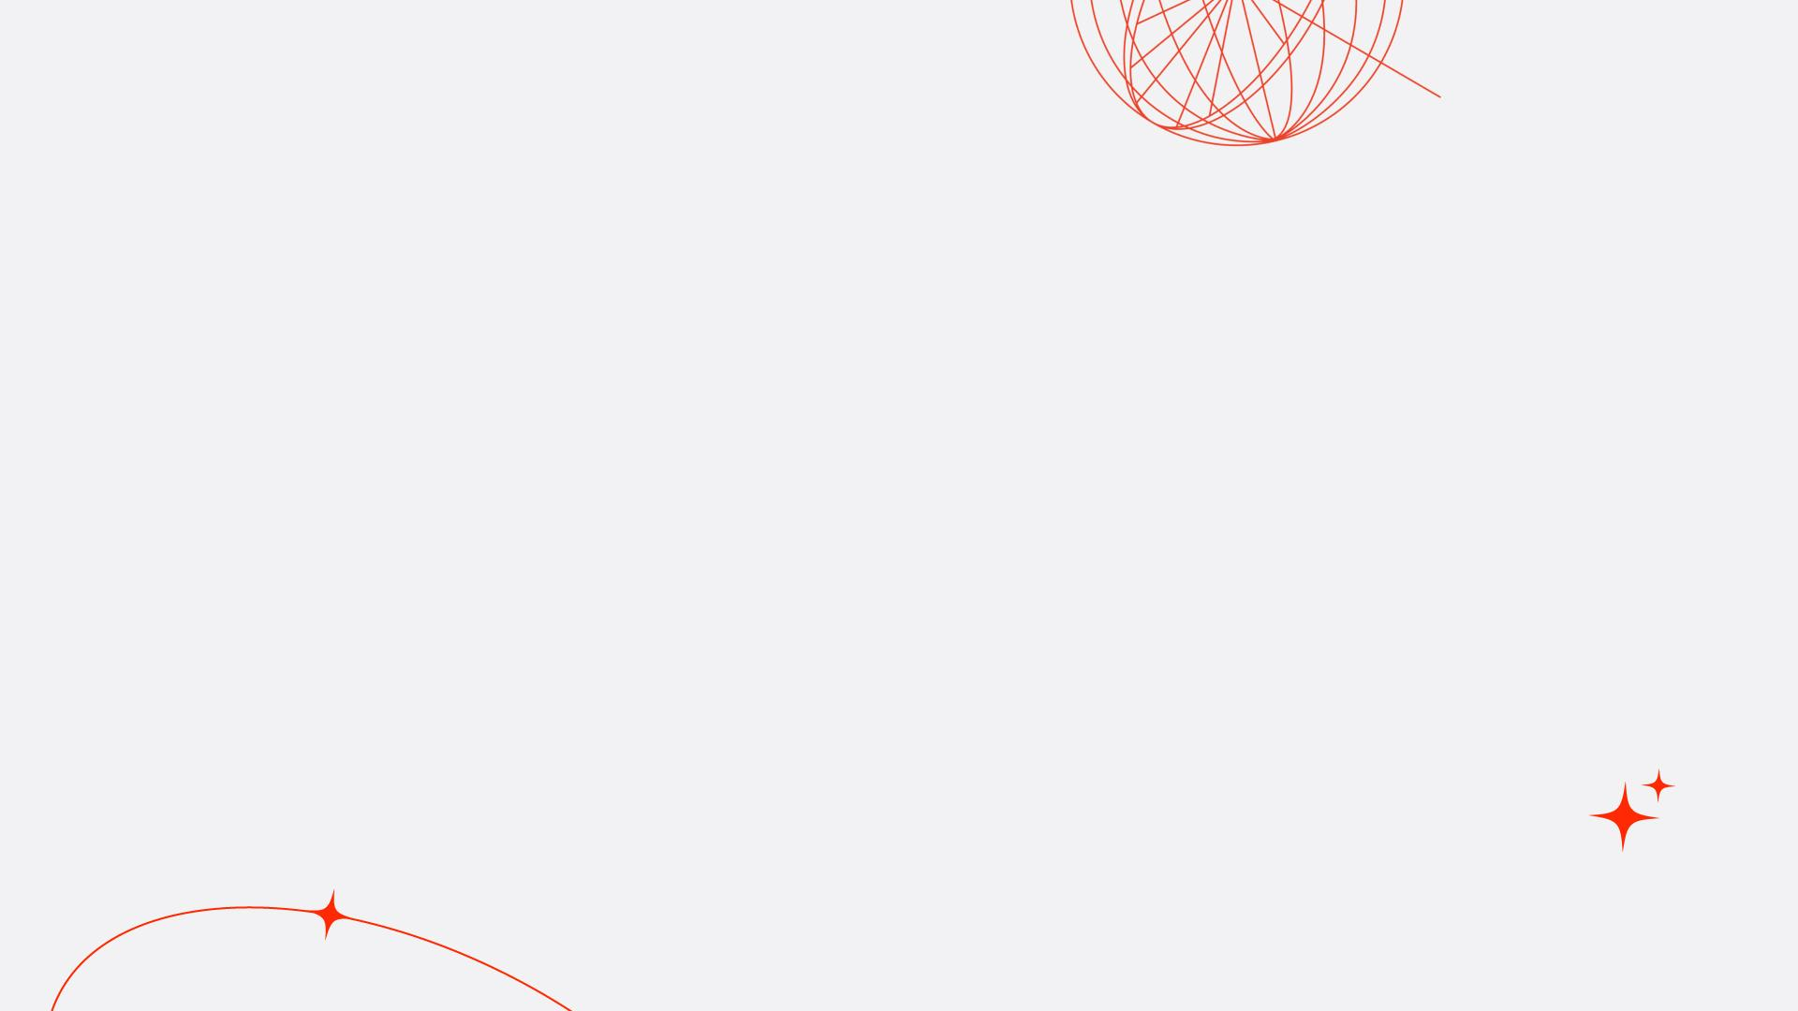
History & Current Situation

Slide 3

v

Slide 4
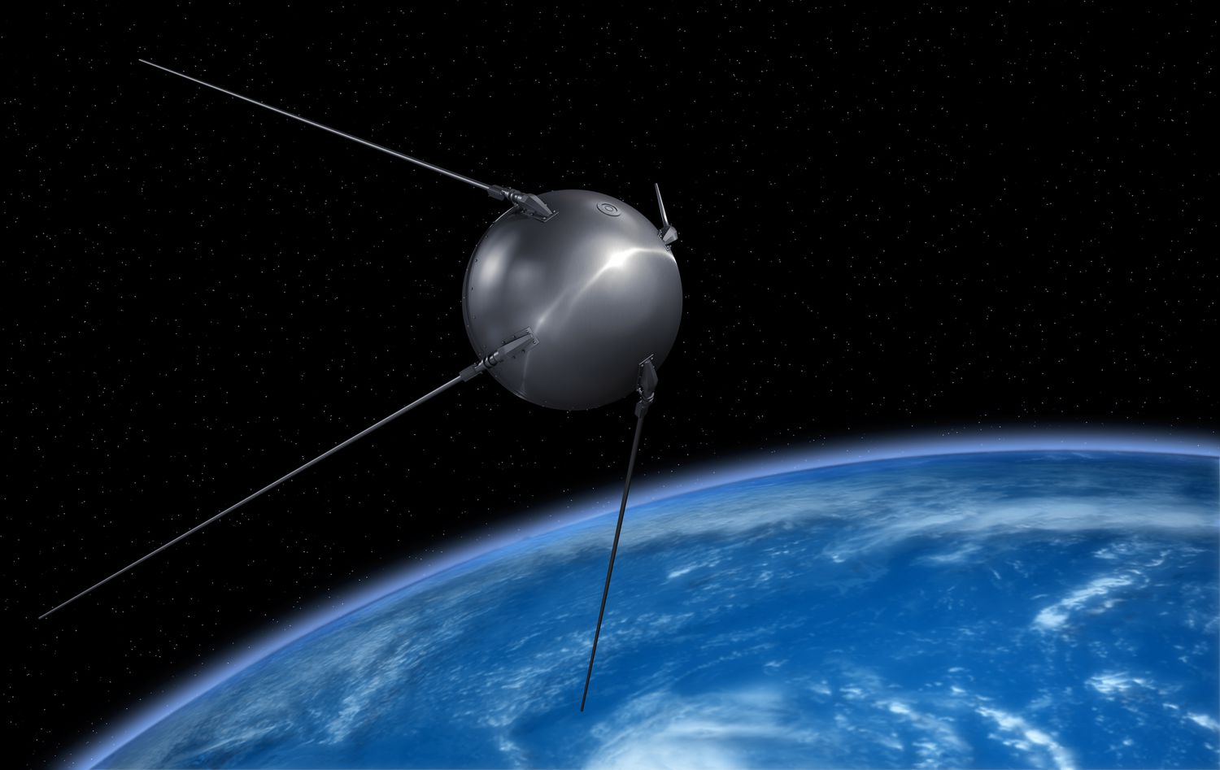
1957
Notes:
Prvotny impulz k rozvoju space sektora – military (ak viem poslat na orbit satelit viem tam poslat aj bombu)

Slide 5
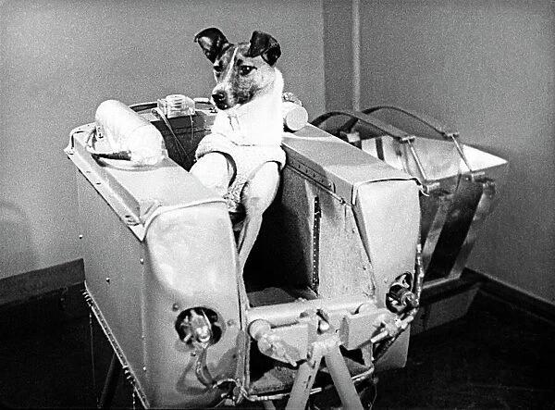
1957
Notes:
Rapidny rozvoj technologii a know-how ako sucast space race medzi ZSSR & USA

Slide 6
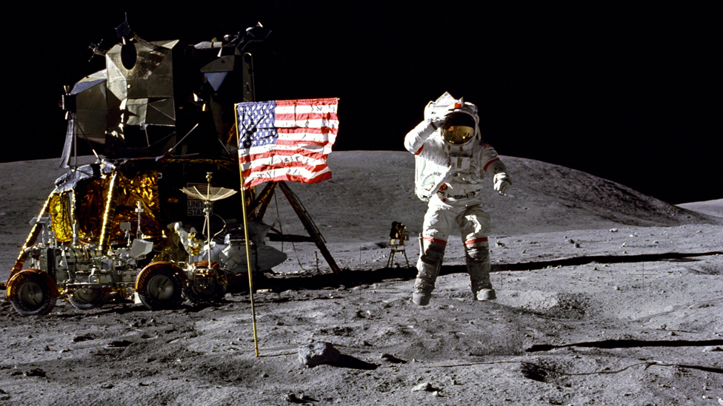
1969
Notes:
Space race vyvrcholil pristanim ludi na mesiaci.

Slide 7
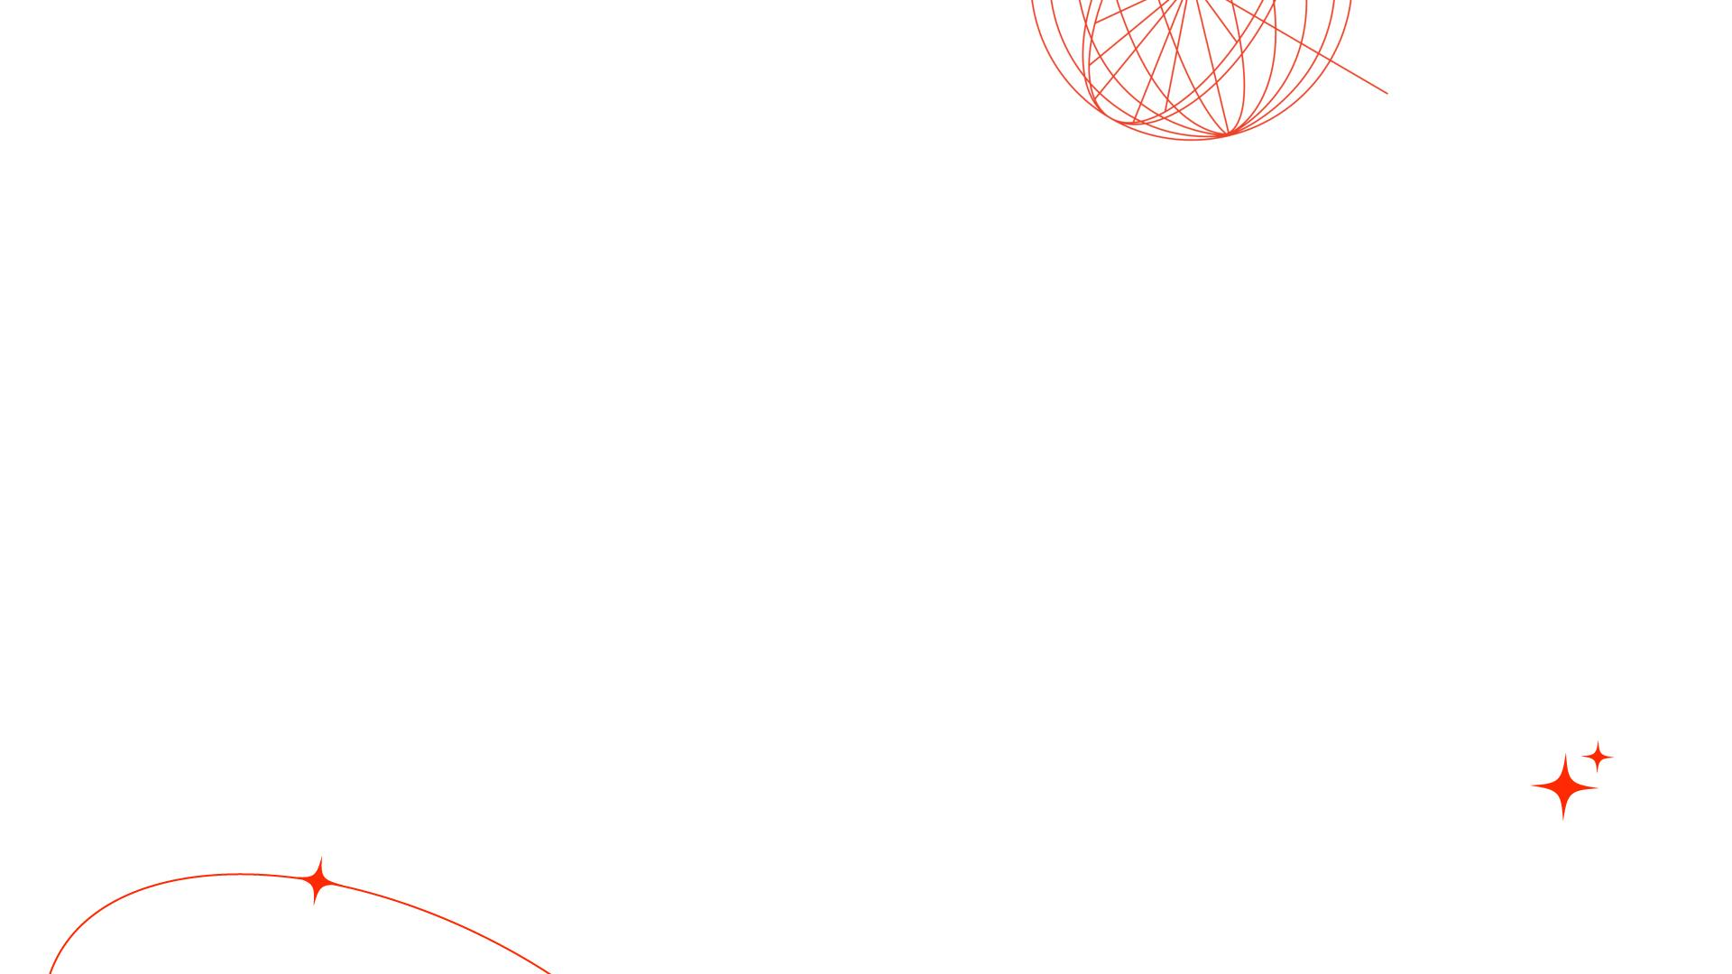
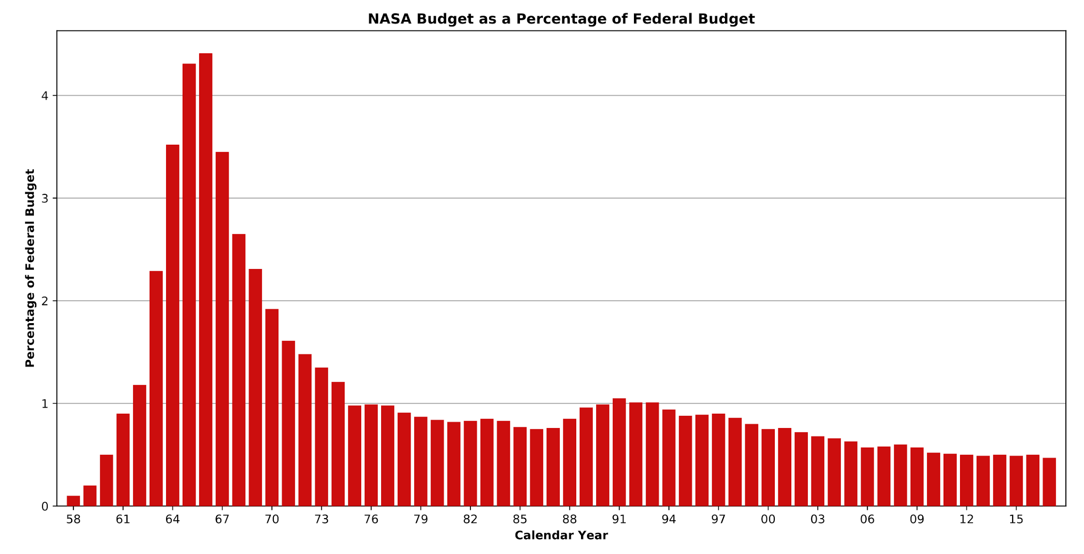
Notes:
Nasledne zaujem o vesmir vyrazne opadol.
Vojenske technologie su uz vyvinute
Konfrontacia zo ZSSR opadava (ekonomicke problemy ZSSR)

Slide 8
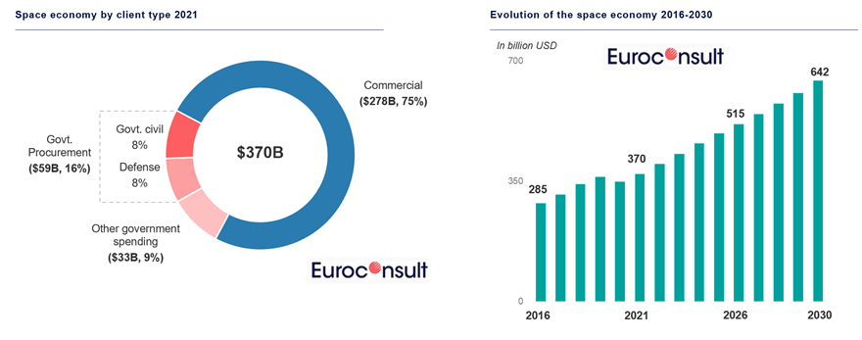
Notes:
Dnes je vesmir primarne komercny segment – 75%
Vesmir patri medzi najrychlejsie rastuce segmenty

Slide 9
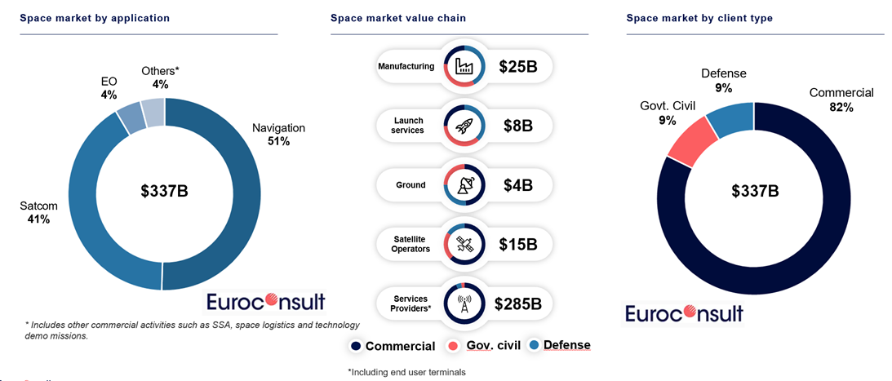

Slide 10
New Internet opportunity

Slide 11

Internet
Space
Originally a government /
military technology
Opened for commercial usage
Rapid decrease of the price
Development of $B companies
In progress
Notes:
Pararela medzi internetom v 90tych rokoch a vesmirom dnes
Ex military technologia
Otvorena pre sukromnu komercializaciu
Konkurencnym bojom & rozvojom technologii sa znizujuca cena = otvorenie priestoru pre nove moznosti (ked stiahnut si film stoji 1000EUR v ucte za internet tak pojdem fyzicky do pozicovne)
Mnozstvo firiem z miliardovou hodnotou (intenret – vela / space – zopar (zatial))

Slide 12
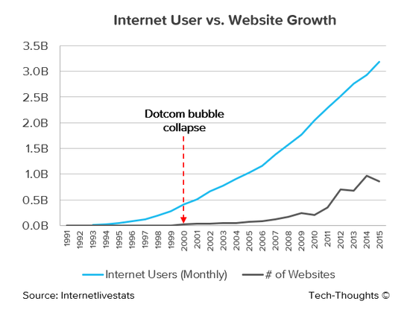





Notes:
Ukazka ,early mover advantage, - prehlad velkych intenretovych firiem a ich zaciatku

Slide 13
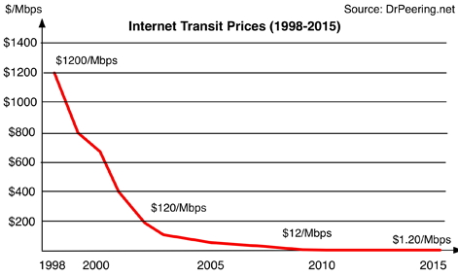
Notes:
Cena za internet

Slide 14
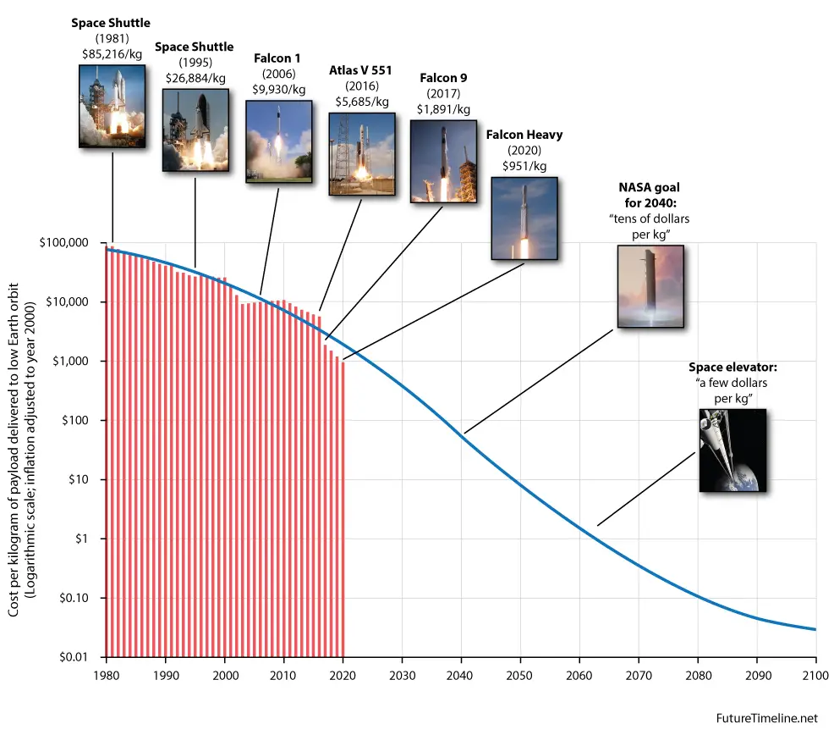
Notes:
Rovnaky prepad ako cena kg na orbit = otvaranie moznosti, ktore doteraz nedavali ekonomicky vyznam

Slide 15
Rockets as an Infrastructure

Slide 16
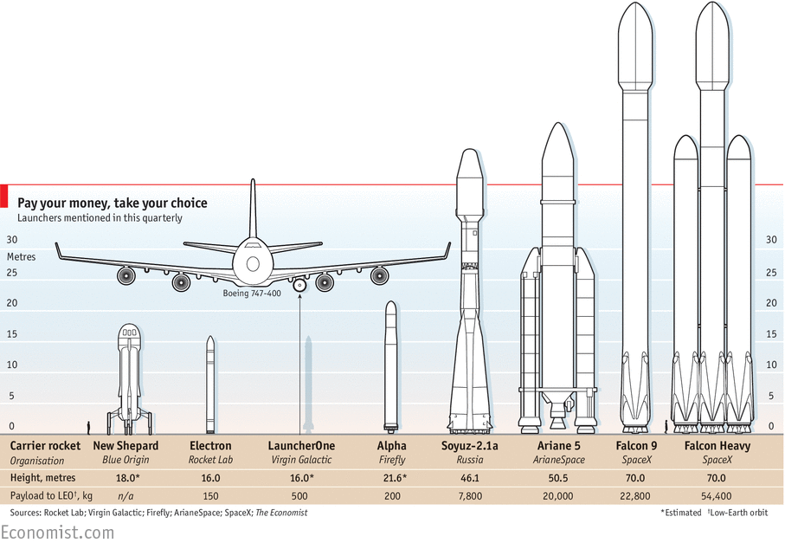
Notes:
Raketova technologia je ,infrastrukturna, vrstva vesmiru. Nieco ako tahanie kablov pri zavadzani internetu.
Otazka vznika – na co sa bude tato kapacita pouzivat

Slide 17
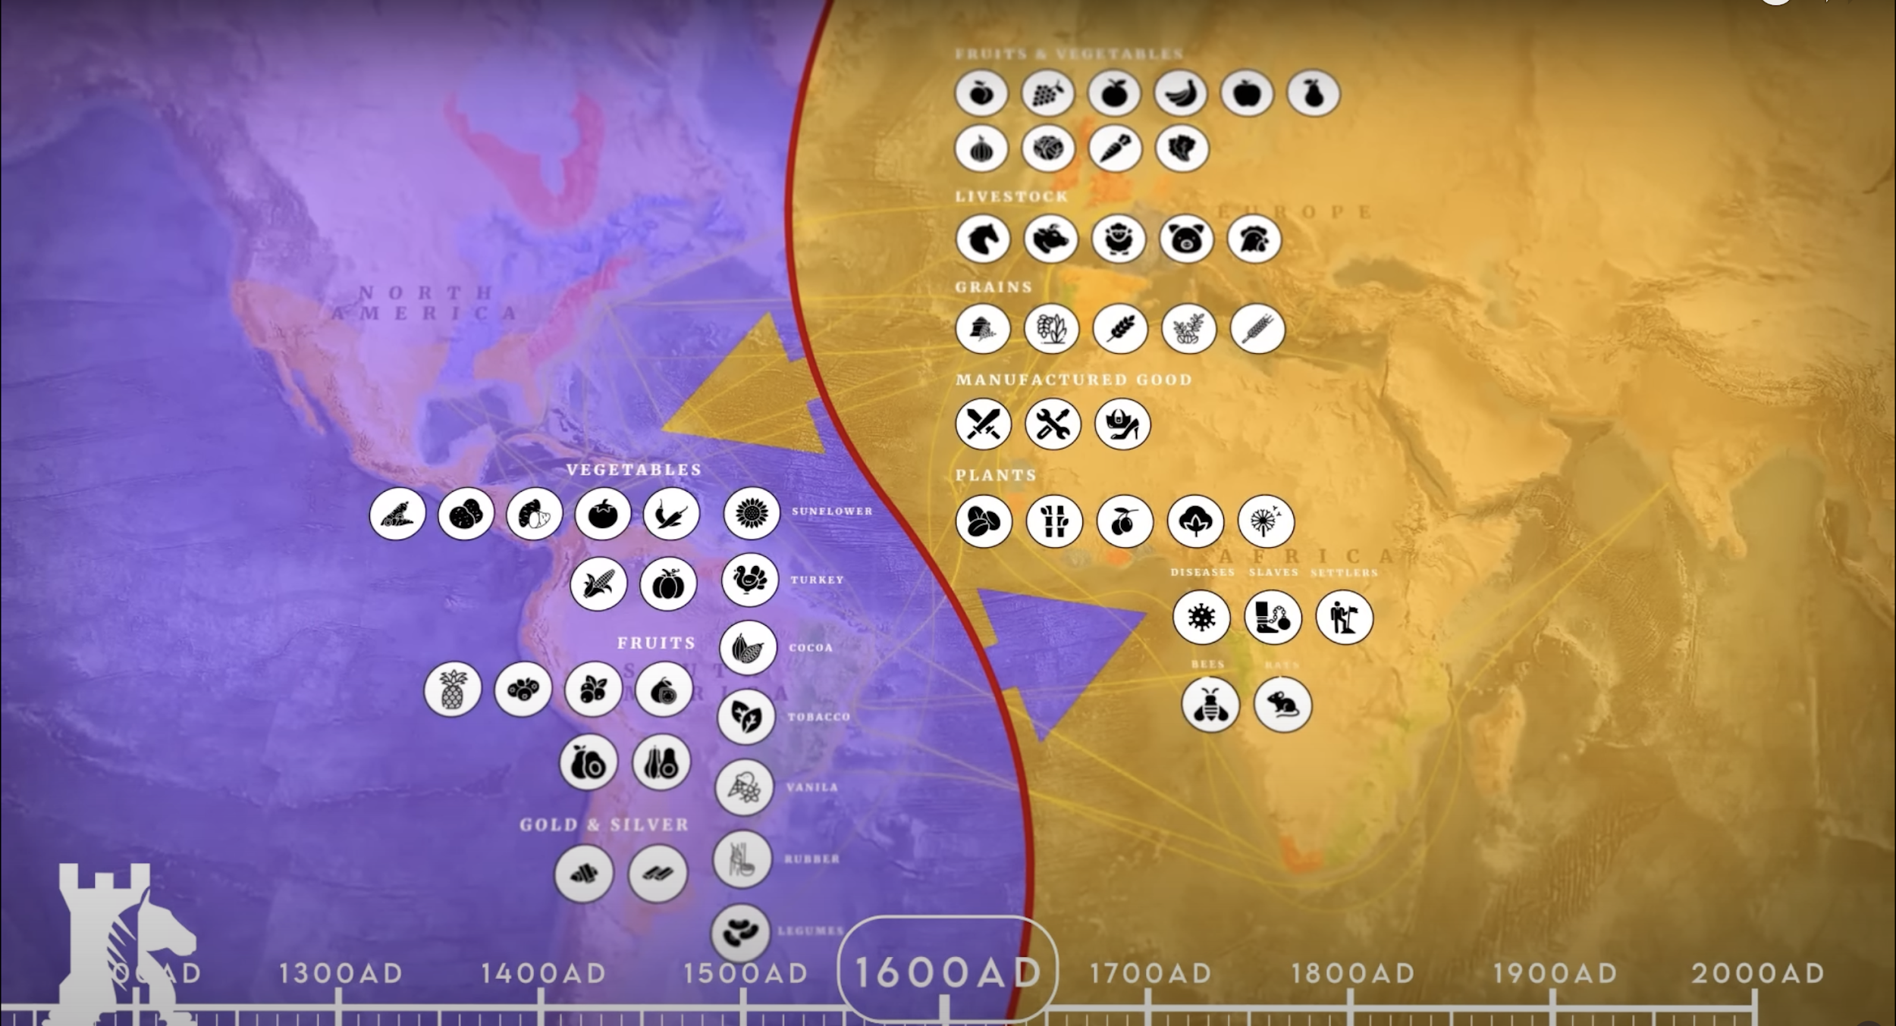
Notes:
Pararela s kolonizaciou planety
- Trade medzi novym svetom (amerika) a Europov bol primarne v ,novych tovaroch, - to co v EU nebolo

Slide 18
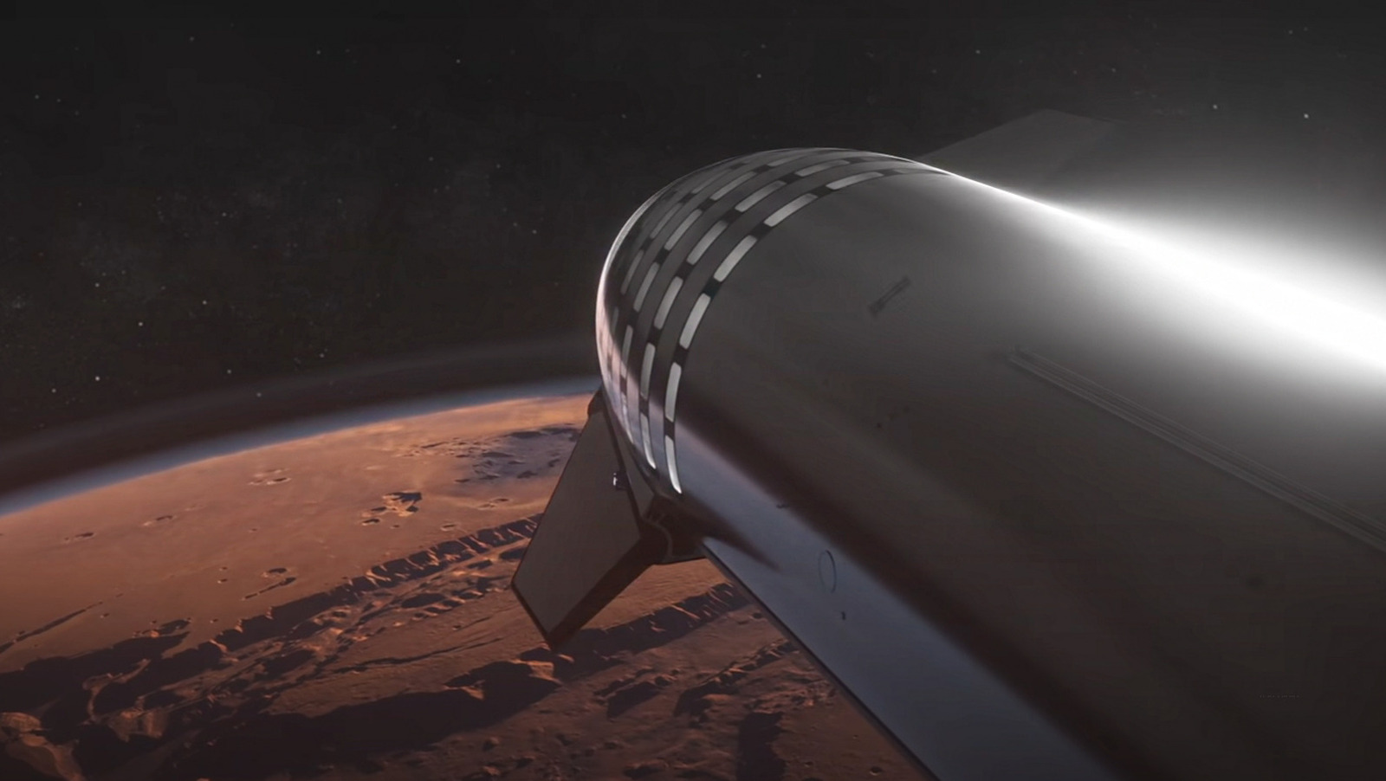
Notes:
Ultimatny rozvoj vesmirneho priemyslu je permamentna kolonizacia dalsich planet / objektov

Slide 19
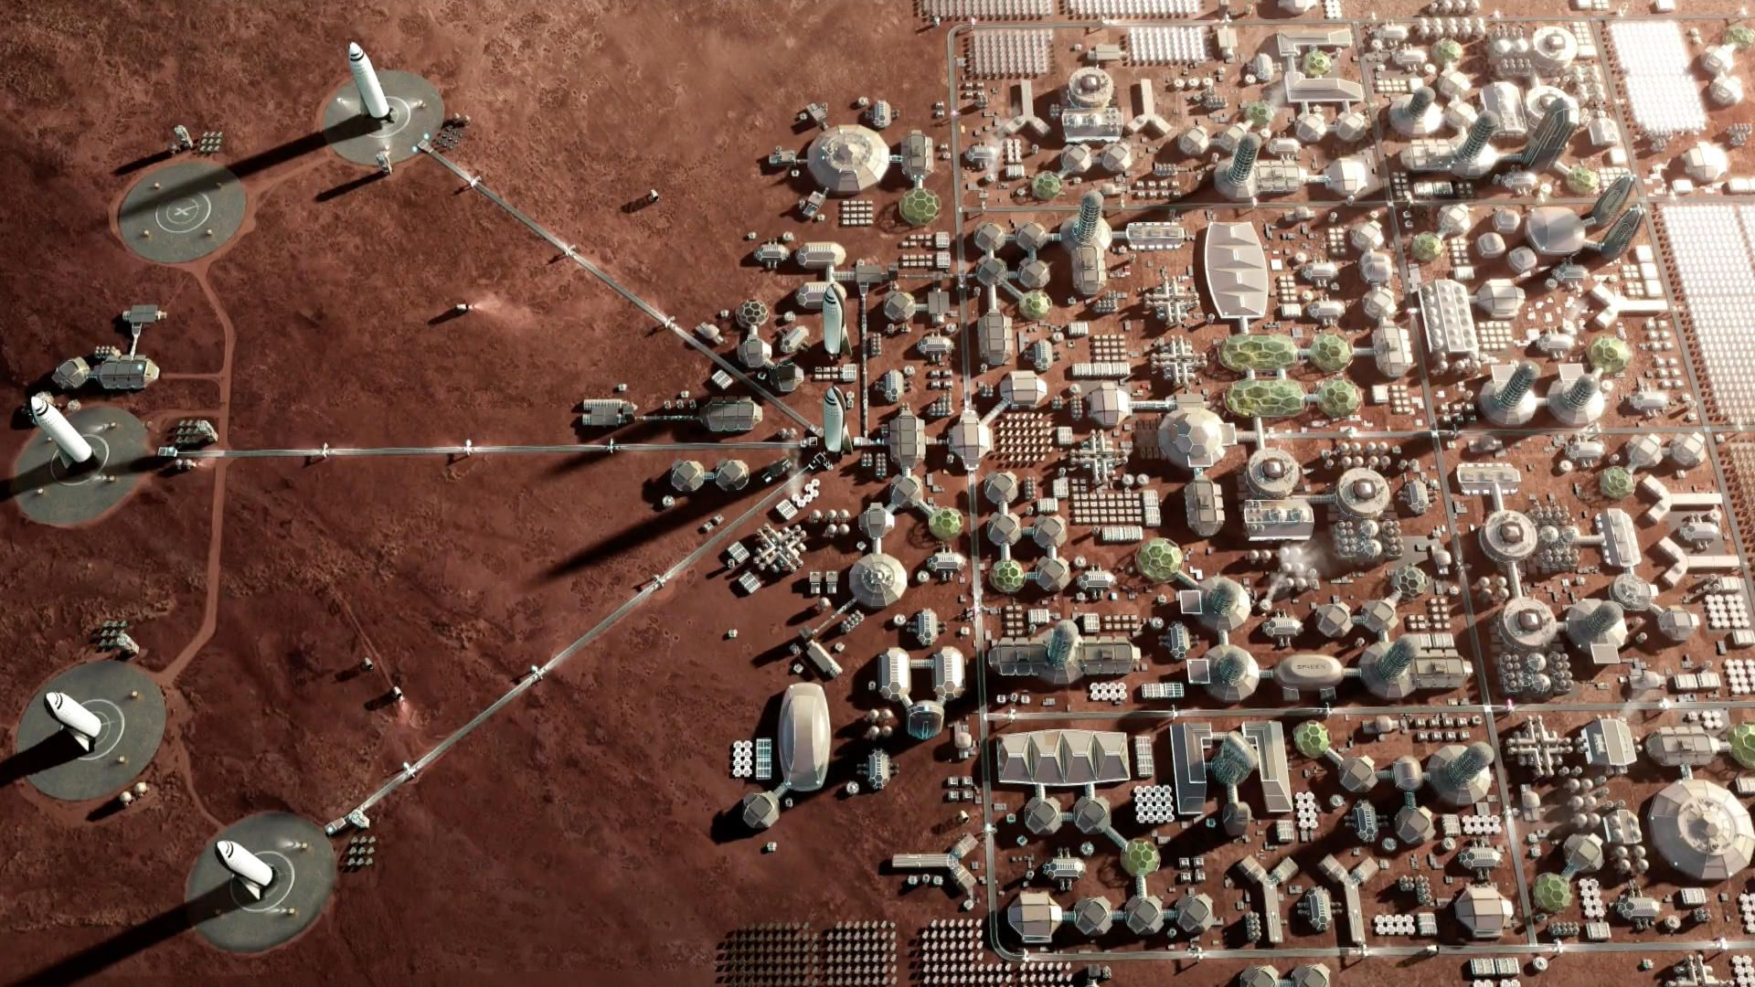
Notes:
A vytvorenie pararelnych ekonomik a ,medzi-planetarneho, obchodu (globalizacia na steroidoch)

Slide 20
Space Technology Roadmap

Slide 21
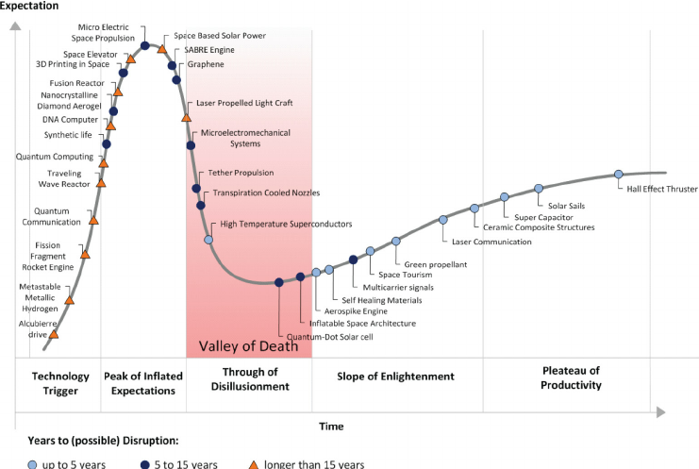
Notes:
Ako pri kazdej prilezitosti vela moznosti je realnych ale este viac dobre znejucich ale uplne nerealnych / alebo realnych daleko v buducnosti.
- Otazka – comu sa venovat teraz

Slide 22
3 stages of future space economy

Slide 23
No Earth
Competition
Are of
no rarity
Inter-space Economy
Stage 1
Stage 2
Stage 3

Slide 24
No Earth Competition
Stage 1
Space enabling new development
(unable to develop on earth)
Products / Services with no price competition –
no substitution possible
Space production – Earth consumption

Slide 25
New development - no substitution possible
Stage 1
Organoids & Organ printing
- improvement of drug development (no pet testing)
- development of personalised organs for individuals
(no transplant donors)
Technology: 3D printing & low gravity environment
Next gen optic fibers
- cutting the time for data transmission between EU & US (high frequency trading)
Technology: People less factory & low gravity environment
Space tourism

Slide 26
No Earth
Competition
Are of
no rarity
Inter-space Economy
Stage 1
Stage 2
Stage 3

Slide 27
Age of no rarity
Stage 2
More mature space age:
high frequency transport to orbit
Production / Services competing for price / rarity on Earth
Space production – Earth consumption

Slide 28
Price / Rarity competition
Stage 2
Space Mining
- supporting earth manufacturing from materials out of the Earth
- mining elements not on Earth – Helium 3
(clean energy)
Technology: transportation of asteroids / high volume logistics
Space Hotel / Cafe Shop (mass space tourism)
- permanent presence of high volume of people in Space / Moon
Technology: High volume accommodation in space / life support
High volume manufacturing in space – just in time on steroids

Slide 29
No Earth
Competition
Are of
no rarity
Inter-space Economy
Stage 1
Stage 2
Stage 3

Slide 30
Inter-space economy
Stage 3
More mature space age:
Fully functional space economy
Space production & Space consumption
Space as a regular address for the business (fully competitive to Earth)

Slide 31
High Value Investment opportunities

Slide 32
New development - no substitution possible
Stage 1
Organoids & Organ printing
- improvement of drug development (no pet testing)
- development of personalised organs for individuals
(no transplant donors)
Technology: 3D printing & low gravity environment
Next gen optic fibers
- cutting the time for data transmission between EU & US (high frequency trading)
Technology: People less factory & low gravity environment
Space tourism

Slide 33
Investment Traps

Slide 34
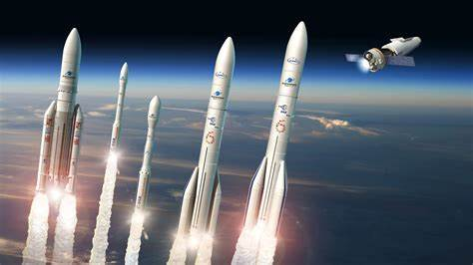
Notes:
Rocket technology
Naskok spaceX je ,nedobehnutelny,
India & Cina maju pokrocile technologie
Boeing & Airbus duopoly -

Slide 35
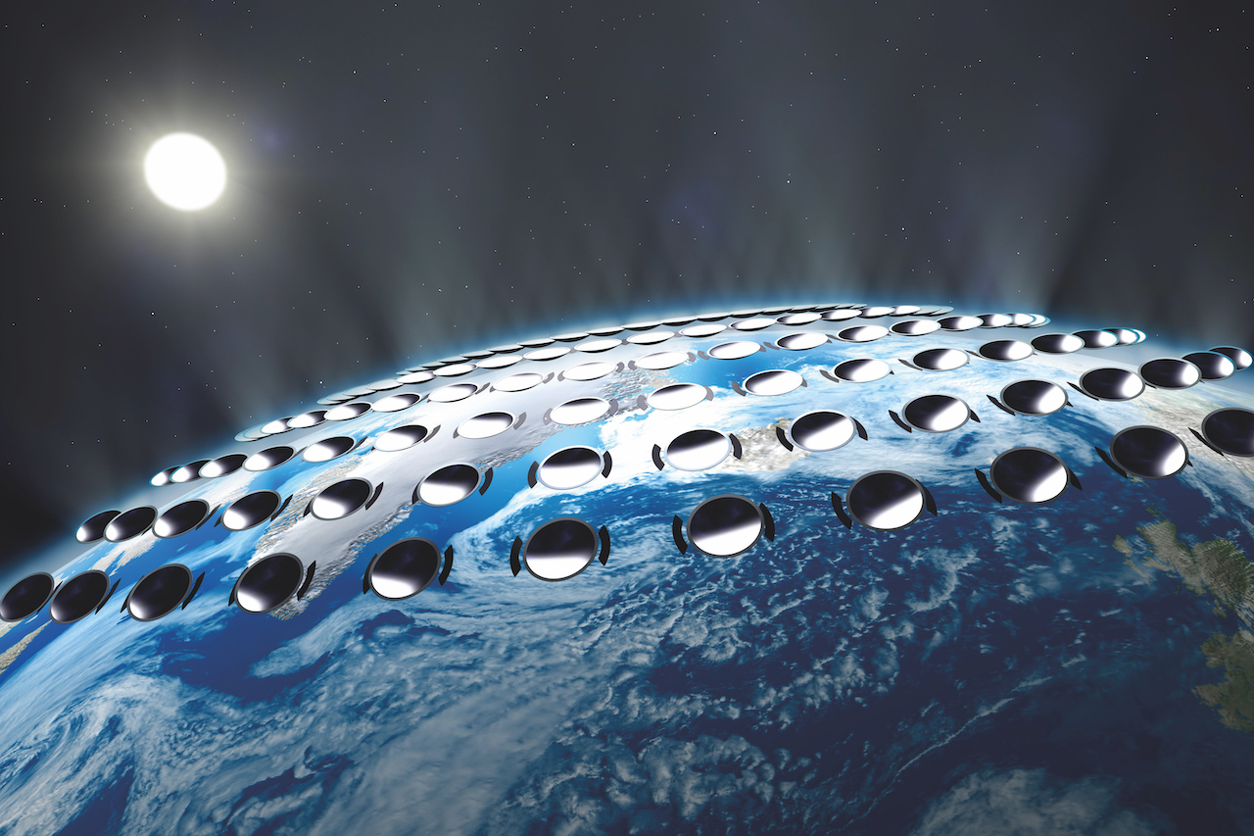
Notes:
Space Geo-Engineering
Legal nightmare
Low business impact

Slide 36
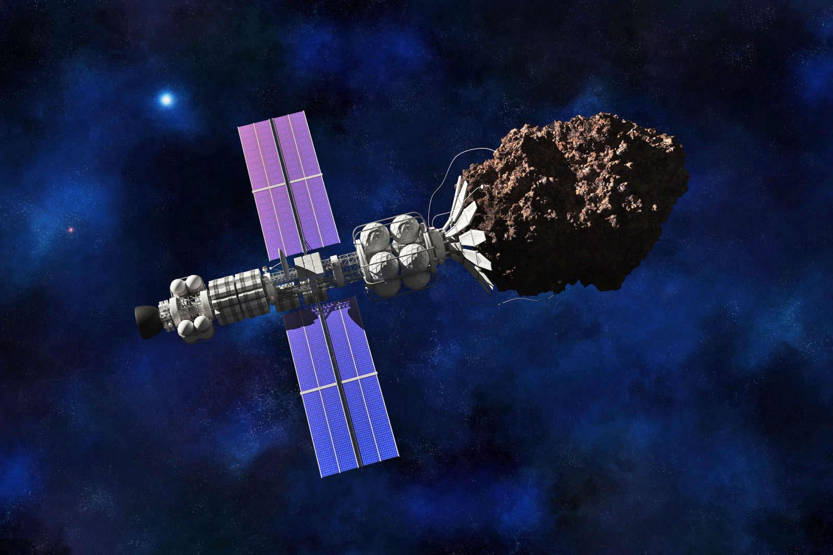

Slide 37
Impact of space on existing biz.

Slide 38
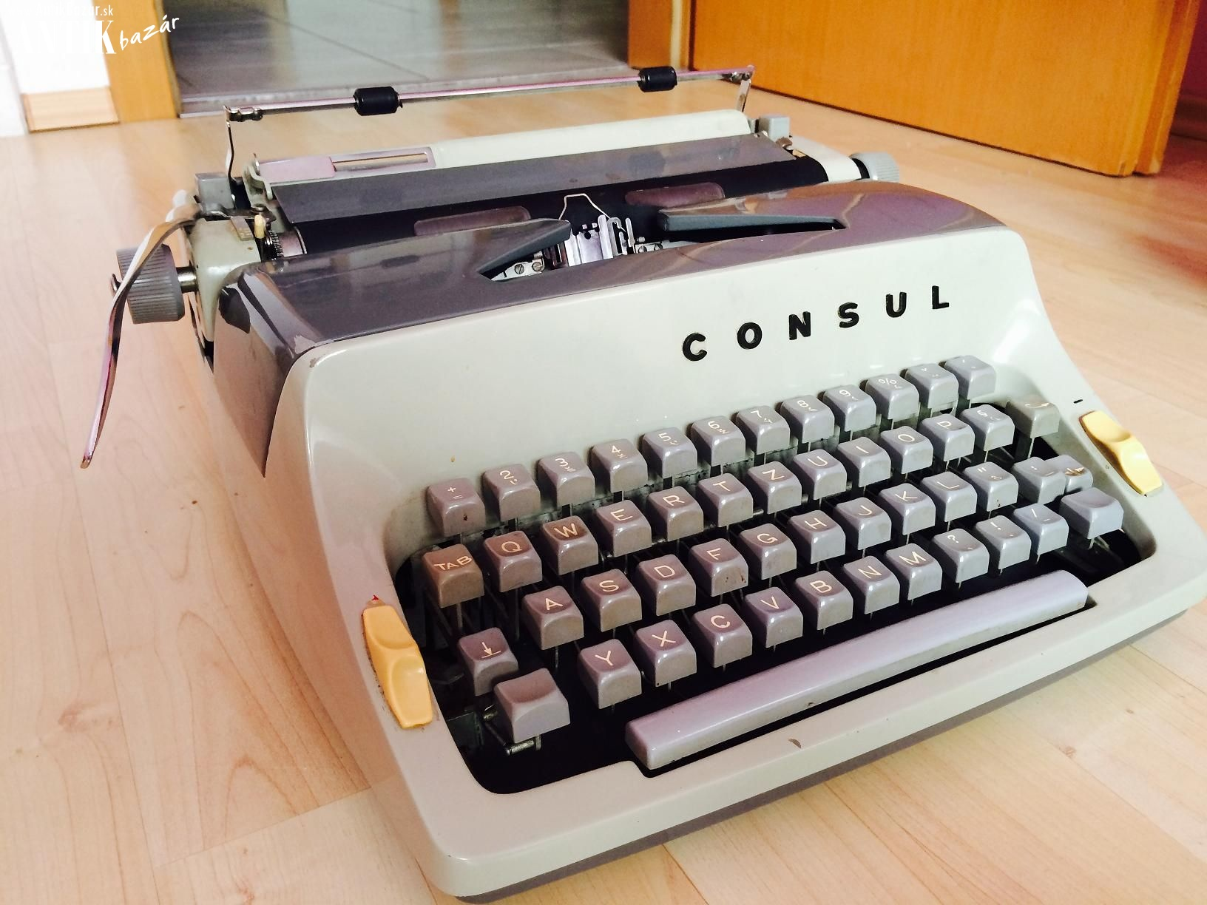
Notes:
S rozvojom vesmiru – a komercializacou vesmirneho potencionalu sa niektore firmy stanu zbytocne

Slide 39
Industries with negative impact
(short-term)
Telecommunication companies
  Mass adoption of LEO satellites (Starlink) could possibly develop a global Telco provider
Specific Pharma sector
  Adoption of drug discovery in space & Adoption of organ printing could annihilate specific pharma segments

Slide 40
Intro VytahConf.

Slide 41
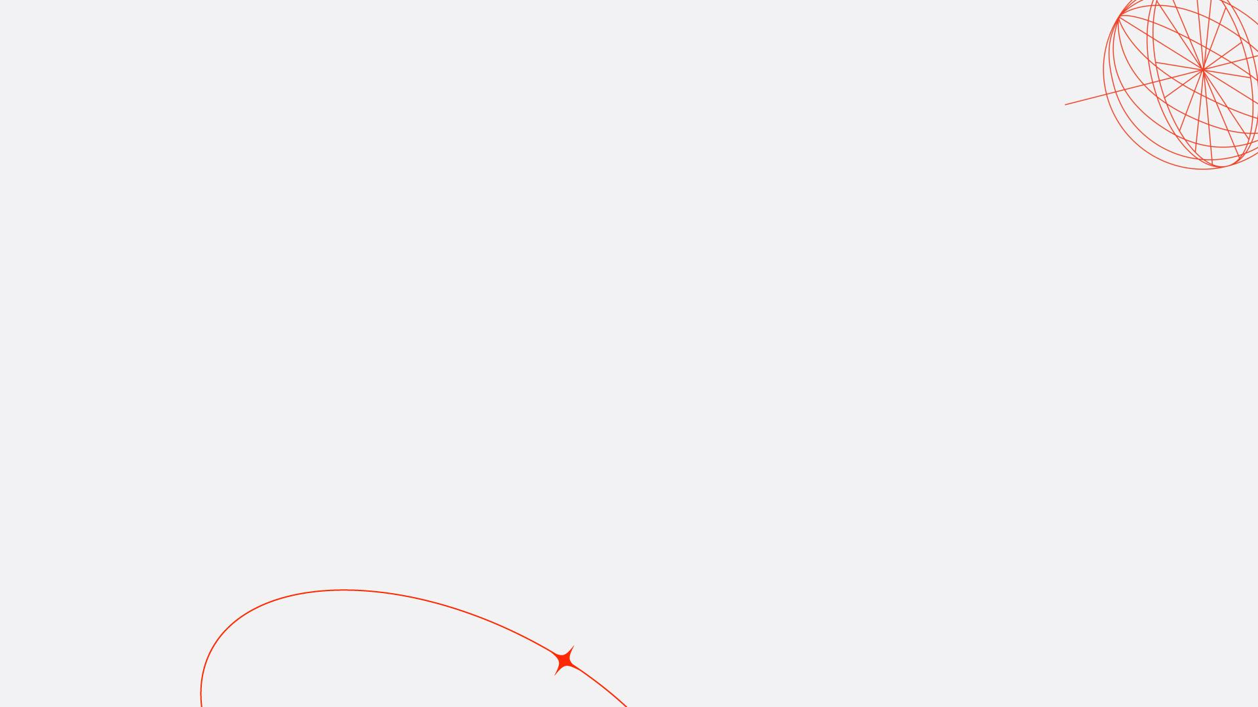
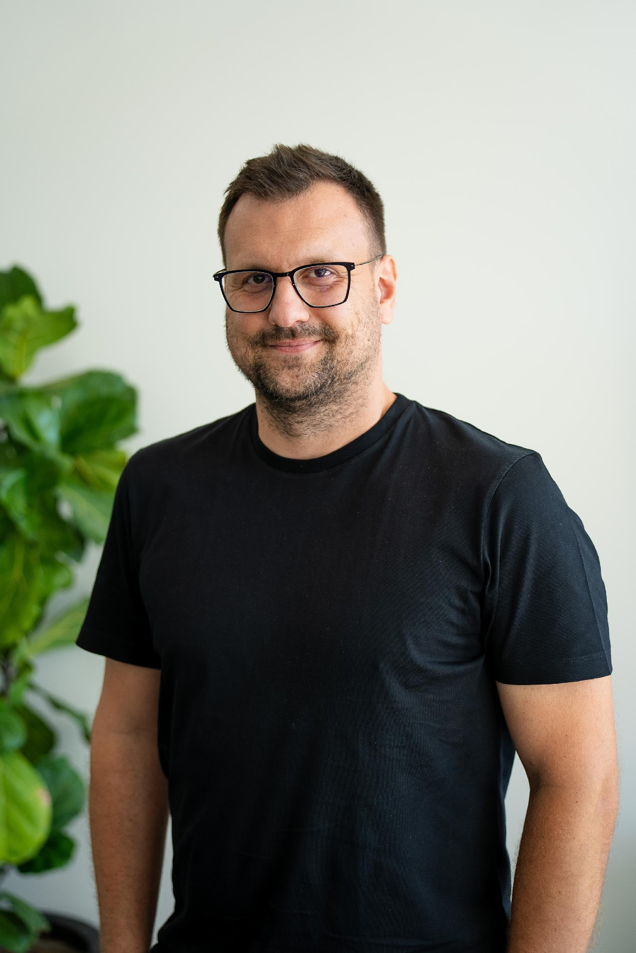
Adam Gala
Marketing & Business Development for various projects
  E-commerce
  Health Tech
  Green Tech
  Deep Tech
Organizer of VytahConf. –
#1 space business conference in Slovakia

Slide 42
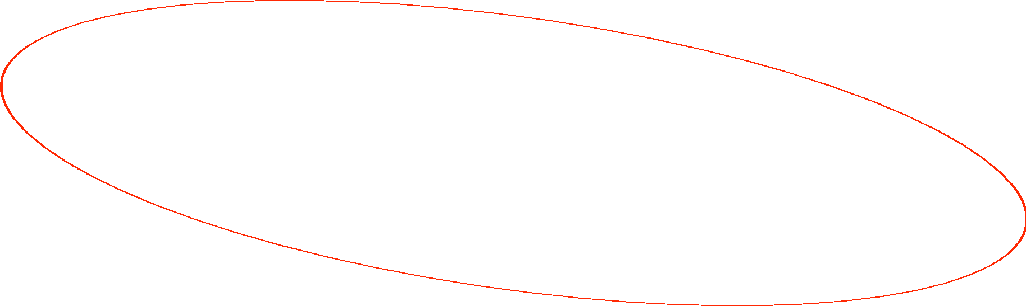




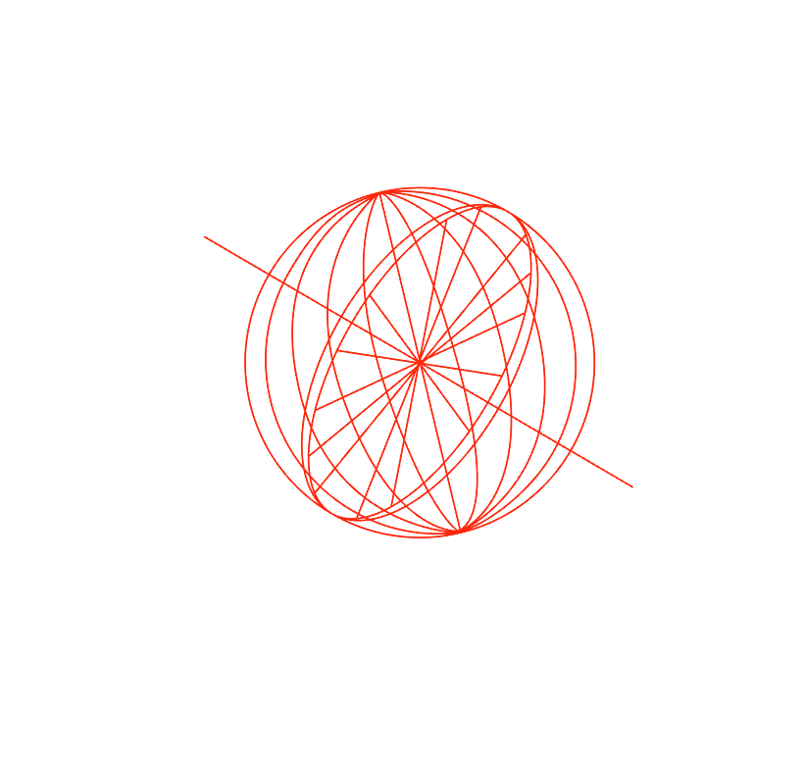
We are VytahConf.com
One day long space business conference
Organised by volunteers
In Slovakia (Central & Eastern Europe)
aiming to facilitate technology & business transfer between space & non-space players.
with personal goal of visiting moon in our lifetime
connecting world with the tech potential & business opportunities of Eastern Europe

Slide 43
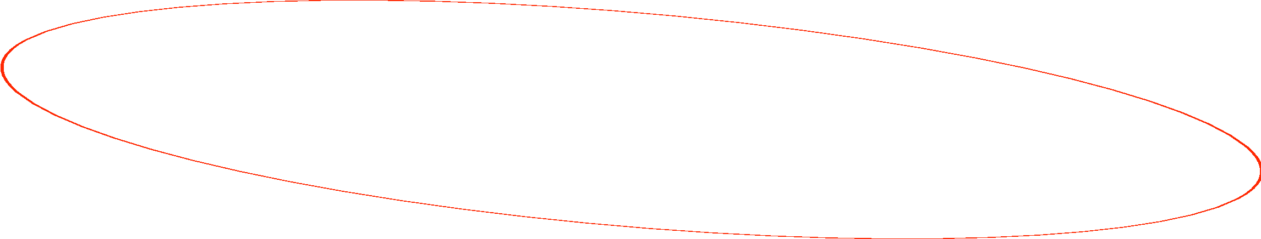
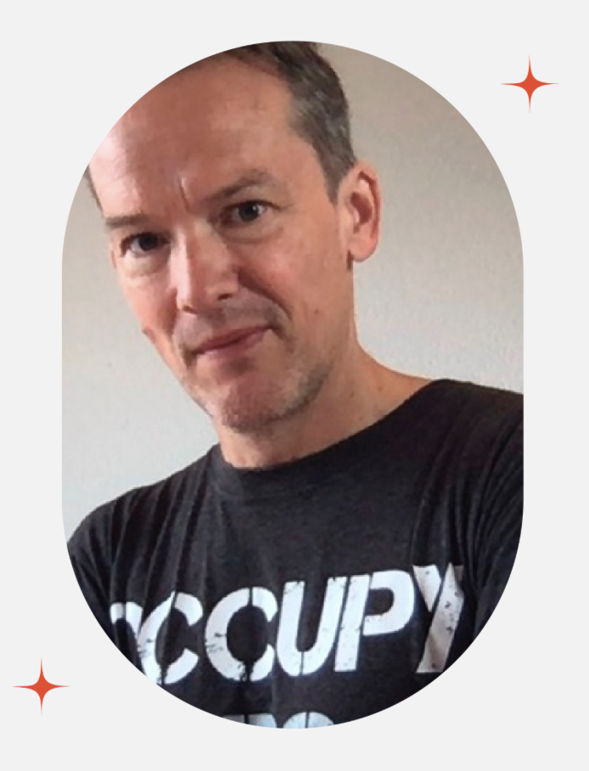
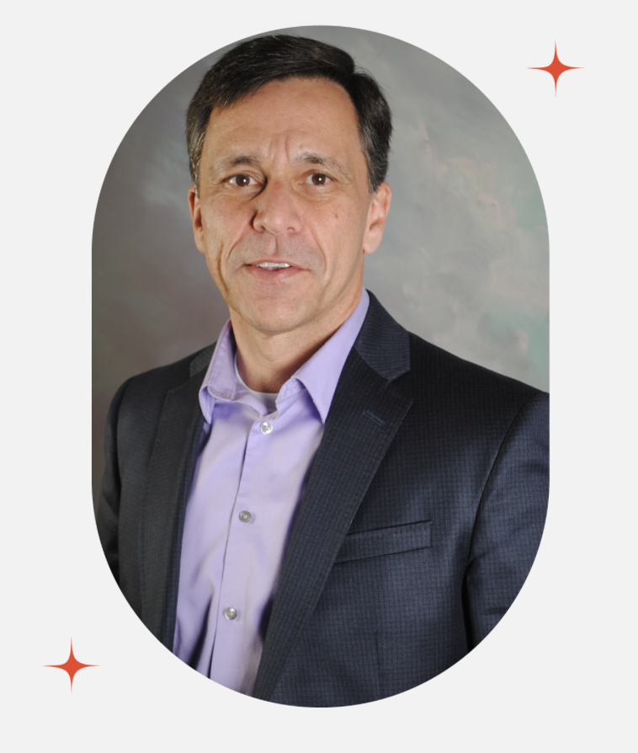
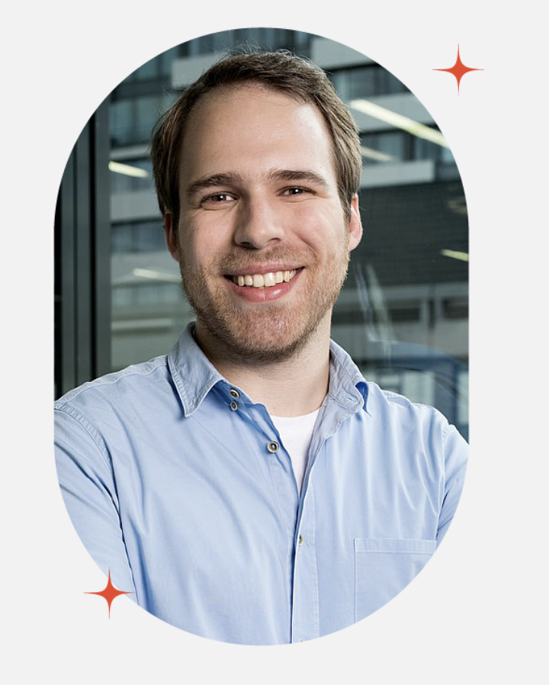

Last event connected
Raphael Roettgen
Guillermo Sohnlein
Johannes Willbold
Kelly Weinersmith
Raphael Roettgen is a space investor educator and businessman.
With a vision of establishing a presence of 1,000 people in the Venusian atmosphere by 2050.
Johannes Willbold is a satellite and space system security researcher and doctoral student at the Ruhr University Bochum.
When she isn’t studying Nature’s creepiest wonders, Kelly is writing books with her husband, Zach Weinersmith.
and 8 other speakers with:
Slovak government
(defence / transportation)
manufacturing companies
automobile supliers
software houses
space & non space startups
students
and 250 other visitors

Slide 44




We want you to be there.
To gain the knowledge
From international speakers & visitors
To establish a personal connection
with individuals, companies, government & academia in central Europe
To explore space opportunities
from your investments & beyond :)

Slide 45
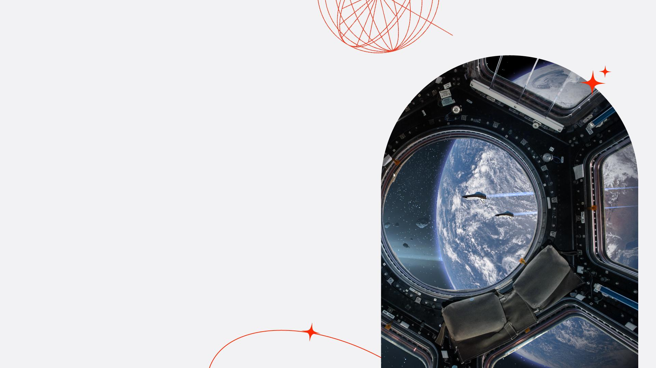
24.4.2025
Slovenská sporiteľňa
adam@vytahconf.com

