Slide 1
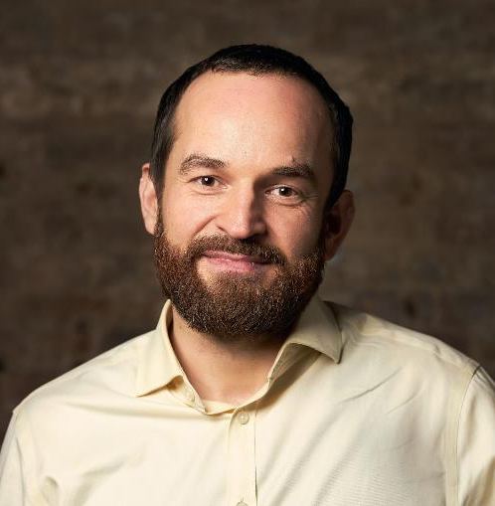
Transforming Fixed-Income Investing with AI-Augmented Solutions
  IGOR TESINSKY
    Founder & CEO

Slide 2









The Problem
Addressing industry challenges with real-time AI-Human collaboration
  Fixed income industry inefficiencies due to underutilization of technology and data:
Portfolio management
Credit research
Risk management
  Manual ‘trial and error’ portfolio construction
  Spreadsheet limitations
  Lack of early-warning
  Slow data processing
  No automated reporting
  Reactive risk response
  Lack of real-time analytics
  Infrequent credit risk assessment
  No automated monitoring

Slide 3
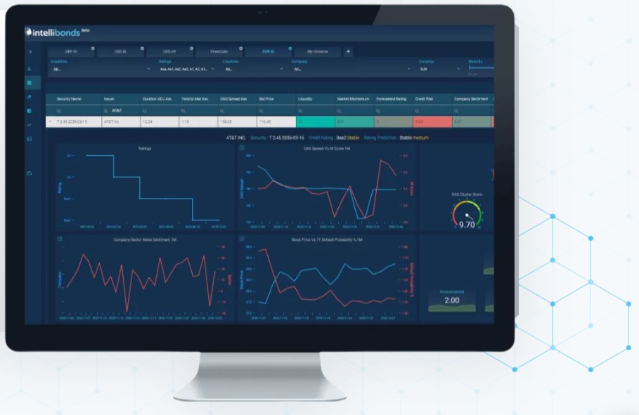
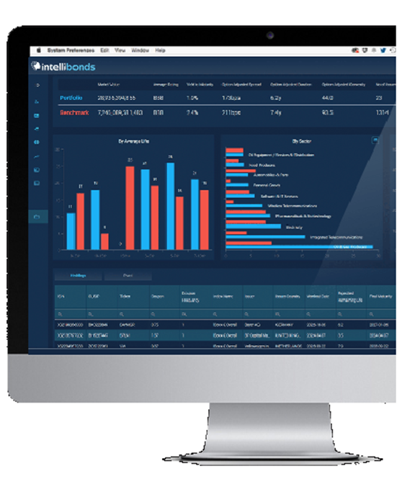
The Solution
Analytical and Gen AI workflow automation for portfolio managers and credit analysts
Portfolio Assist
Credit Assist
        Portfolio construction, optimization, and algorithmic monitoring
        LDI/ALM strategy development and backtesting
        Trade idea generation delivering a 10-40 bps yield pick-up
        AI-powered Credit Rating and Spread predictions
        Multi-factor predictive bond scoring (IB/RV/Custom Scores)
        Automated workflows including investment recommendations and 24/7 credit risk monitoring

Slide 4


_{Live Product Demonstration}
4

Slide 5
Use Case 1: Asset Manager A
Asset Manager A has many large and complex fixed income portfolios. Portfolio construction was spreadsheet based. Workflows between the PMs and quant desk were fragmented, data would become outdated and constraint breaches occurred. The need to incorporate and optimize with respect to their own proprietary bond scoring and risk models is a key requirement.
The problem
The platform is user-friendly and highly customizable on a firm-by-firm basis, allowing for quick implementation of unique setups and models.
Our optimization engine coupled with extensive universe coverage empowers PMs to generate the best performing portfolios subject to highly specific constraints. Furthermore, we incorporate liquidity and transaction costs and provide a list of similar actionable alternative trades for each recommendation.
Intellibonds solution
Portfolio rebalancing reduced from days to seconds with the latest data always incorporated.
Optimal portfolios with improvements in any metric the PM wished to enhance (internal scores/yield/spreads etc), without altering the risk exposures and with all constraints adhered to.
The results

Slide 6
Use Case 2: Pension Fund B
Pension Fund D manages a defined benefit pension scheme with a host of future payments they will have to cover. They need to rebalance a bond portfolio such that the income generated from the underlying holdings matches these liabilities while minimizing transaction costs.
The problem
Intellibonds’ Portfolio Assist allows users to input their liabilities by year and corresponding lower and upper limits that the overall portfolio cash flows must adhere to. Additionally, they can specify the ratio required for the present value of assets vs liabilities. The ability to incorporate predictive trade ideas, control for transaction costs and a list of actionable alternate trades for each recommendation allows the user to generate optimal portfolios at the lowest possible cost and algorithmically monitor them.
Intellibonds solution
An optimal portfolio with respect to client’s objectives and constraints that generates income closely matched to the client’s input liabilities while keeping transaction costs within user defined limits.
Platform notifies client of changes in rating predictions, allowing client to manage credit risk proactively.
Intellibonds platform allows for regular rebalancing, enabling client to closely match liabilities even if market conditions change.
The results

Slide 7
Use Case 3: Private Bank C
Private Bank B was looking to launch a high yield fund in USD. With a pre-existing idea of the inception holdings, they came to us in an attempt to enhance the yield whilst adhering to the prescribed mandate.
The problem
The platform is designed to enable investment strategy development, testing and monitoring. The Intellibonds backtest suite will allow users to simulate their investment strategy and observe how such strategy would have performed historically.
Intellibonds solution
Portfolio set-up, including constraints specification, and subsequent rebalancing took minutes instead of days.
We increased portfolio yield by 60bps, while maintaining average credit rating and market risk, and only slightly increasing duration.
The results

Slide 8
Use Case 4: Insurance Company D
Insurance Company C’s primary concern was avoiding material downgrades within the portfolio that could lead to materially higher capital charges.
The problem
The Intellibonds platform provides advanced rating forecasts. These forecasts provide an invaluable early warning credit risk system which can easily be incorporated into the investment process. This helps our clients avoid large losses associated with adverse credit events or rating action in their portfolios.
Intellibonds solution
During portfolio construction/rebalancing, bonds with predicted negative rating action are filtered out.
Platform notifies client of changes in rating predictions, allowing client to manage credit risk proactively and avoid forced selling.
The platform shows derived peer groups, enabling client to instantly find suitable alternatives including issuers with positive forecasted rating actions.
The results

Slide 9
Contact us
UK Office
IntelliBonds Ltd, Level 39,
One Canada Square
London, E14 5AB
LinkedIn
linkedin.com/company/intellibonds
Email
igor@intellibonds.com
Twitter
@intellibonds
www.intellibonds.com
‘We are revolutionising the fixed income front office by combining unique human skillset with top-of-the-line AI technology to create a smoother, more efficient and cost-effective workflow.’
CEO and Founder, IntelliBonds

